Slide 1



Git & GitHub 101
The basics of Setting up Version Control
Session Objectives:
- To enable the participants to integrate Git and GitHub as a version control system as well as code sharing platform for their day-to-day research works at ChoLab

Slide 2
What is Git?
Git is a version control system.
It tracks changes in files over time and allows you to collaborate safely.
It was created in 2005 by Linus Torvalds

Slide 3
Why do we need Git?
Documentation Versions:
Project.docx
Project_V2.docx
Project_final.docx
Project_final_V2.docx
Project_final_Real.docx
Git is the solution to this problem.

Slide 4

What is GitHub?
GitHub is a cloud-based platform that hosts Git repositories.
It allows you to:
Store your Git projects online
Collaborate with others
Track issues and project tasks
Share and showcase your work

Slide 5

What is the difference between Git and GitHub?
Git and GitHub are independent, related yet different from each other.
Git | GitHub
Version control tool | Cloud hosting platform
Runs locally | Runs online
Tracks changes on your computer | Shares projects between users

Slide 6
Let’s setup git: One time Process
Install Git:
https://git-scm.com/install
To setup git username and email
$ git config --global user.name “YOUR NAME”
$ git config --global user.email “YOUR EMAIL”
Verify: $ git config --global –-list
$ git config --global init.defaultBranch main

Slide 7
Let’s setup GitHub: One time Process
Sign Up and create an account:
https://github.com
Authenticate git to github:
Mac: brew install gh
Windows: winget install --id GitHub.cli
Verify: $ gh --version
$ gh auth login
$ gh auth status

Slide 8
We are set up to use both Git and GitHub

Slide 9
Git Commands
Git Commands that we will try to cover in this session:
Init
Add
Clone
Commit
Push
Pull
Fetch
Log
Diff
Branch
Switch/ checkout
Merge
Restore
Reset
Revert

Slide 10
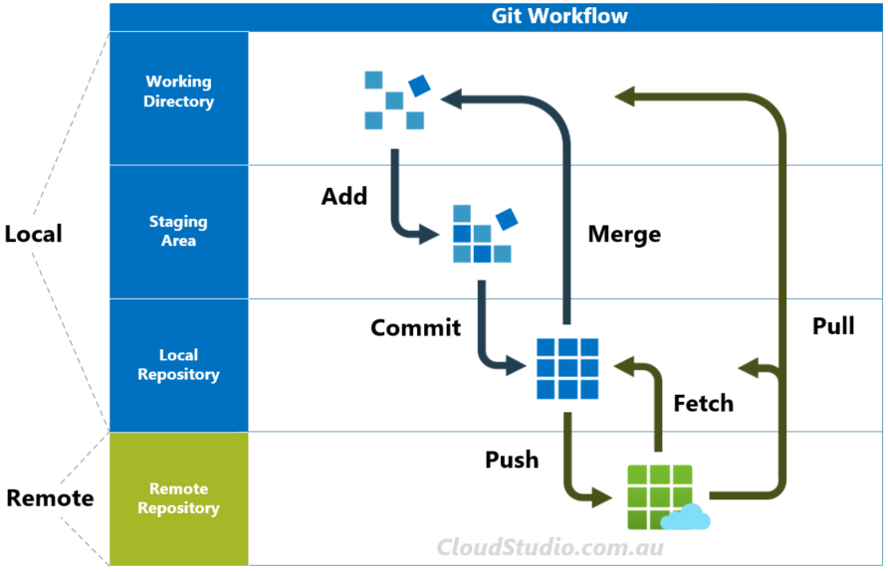

Slide 11
Starting a new project repo
In your repository, initialize a new git repository:
$ git init
Add all the files:
Adding files means you are staging the changes
Use it when you are ready to save your work to a commit.
$ git add .
Committing the changes:
This saves your staged changes to your local repo history
Use it when you are ready to save a log of your work as a new version
$ git commit –m “THIS IS THE COMMIT MESSAGE”
Creating a new repository (Create one from github first)
$ git remote add origin <repo>
Push the changes to remote repository (GitHub)
$ git push –u origin BRANCH_NAME
Git Status Check:
Use this when you want to check
what is the status of this git repo
in your local device, in short: you want to
See what files are staged and not!
$ git status

Slide 12
Working with Branches
Main
See what branch you are in
$ git branch
Create a new Branch or to switch branch:
$ git switch –c BRANCH_NAME
$ git switch BRANCH_NAME
Rename a branch
$ git branch –m NEW_BRANCH_NAME
Delete a branch
$ git branch -d feature/edge-effect-2016
Main
Branch
Main + branch

Slide 13
Working with Branches
Push your branch to GitHub
$ git push -u origin feature/edge-effect-2016
$ git push
Pull from the main to the branch
$ git merge main
Merge the branch to main
$ git merge BRANCH_NAME

Slide 14
Working on Merging
Merging is the combine codes between your branch or the local-remote repository versions
$ git merge <branch>
A safe way to pull change from remote repository:
git fetch origin
git merge origin/main
Abort the merging process:
git merge --abort

Slide 15
“Save my life” Commands
Restore a file to the last commit state:
$ git restore path/to/file
Undo add commands:
$ git restore --staged path/to/file
Check your log history:
$ git log
Restore a file from a specific commit phase:
$ git restore --source <COMMIT_HASH> path/to/file
Peek into a commit and come back again:
$ git switch --detach <COMMIT_HASH>
$ git switch main
Wipe all the files to specific change:
$ git reset --hard <COMMIT_HASH>

Slide 16
Working with an existing project
Cloning a project:
Copies the entire GitHub project onto your computer.
Use it to start working on an existing lab project.
$ git clone https://github.com/USER/REPO.git
MAKE YOUR CHANGES TO THE REPO
Pull Changes:
Between your cloning and current time, there might be changes made to the original repo.
So, it is always a good practice to pull the changes to your local directory before making changes each time.
$ git pull origin main
MAKE YOUR CHANGES TO THE REPO
Push Changes:
$ git push
$ git push –u origin BRANCH MAIN
Opening a Pull Request:
You might not have the right to make direct edits to the repository. Use this when you want to request those with the rights to include your changes in the repository so that it is accessible to all.

Slide 17
Opening a Pull Request
Login to GitHub
Browse to your repository
At the top of the repository, it will show the changes made and if you would like to create a Pull Request.

Slide 18
Working on Open-Source Projects
Forking a project:
Forking a repository means you create a copy of the repository on your GitHub; Open-Source Repositories do not allow anyone to make direct commits; unless authorized exclusively.
Cloning a project:
Copies the forked GitHub project onto your computer.
Use it to start working on your version of the project.
$ git clone https://github.com/USER/REPO.git
Define the upstream
You have linked to your version to the project but you also need to link to the original version so that you can pull updates from there too:
$ git remote add upstream LINK_TO_ORIGINAL_REPO
MAKE YOUR CHANGES TO THE REPO
Pull Changes:
You need to pull from upstream and then update both your local as well as remote repository.
$ git pull upstream main
$ git push origin main

Slide 19
Working on Open-Source Projects
Push Changes:
You push to your forked remote repository, you will create a pull request to send it to the original repository
$ git push
$ git push –u origin BRANCH MAIN
Opening a Pull Request:
You will almost always have to request to merge the changes that you made in your fork to merge it to the original repository.

Slide 20
Additional resources
https://git-scm.com/cheat-sheet
https://docs.github.com/en/get-started
https://youtu.be/mAFoROnOfHs

Slide 21
“Every great project begins with a first commit. Don’t be afraid to push.”

Slide 22

Any Questions?

Slide 23

Thank You!
Thank you to Dr. Cho for providing me with this opportunity and for the Cho Lab Members for attending this session. This was my attempt to contribute to learning as a group.
Samar Ranjit
Undergraduate Research Assistant
Cho Lab, TXST
samarranjit@txstate.edu
https://samarranjit.com.np

